Slide 1
Image Inpainting In CVPR20 & ECCV20
Zibo Zhao

Slide 2
Paper
(CVPR2020) UCTGAN: Diverse Image Inpainting based on Unsupervised Cross-Space Translation
(ECCV2020) Guidance and Evaluation: Semantic-Aware Image Inpainting for Mixed Scenes

Slide 3
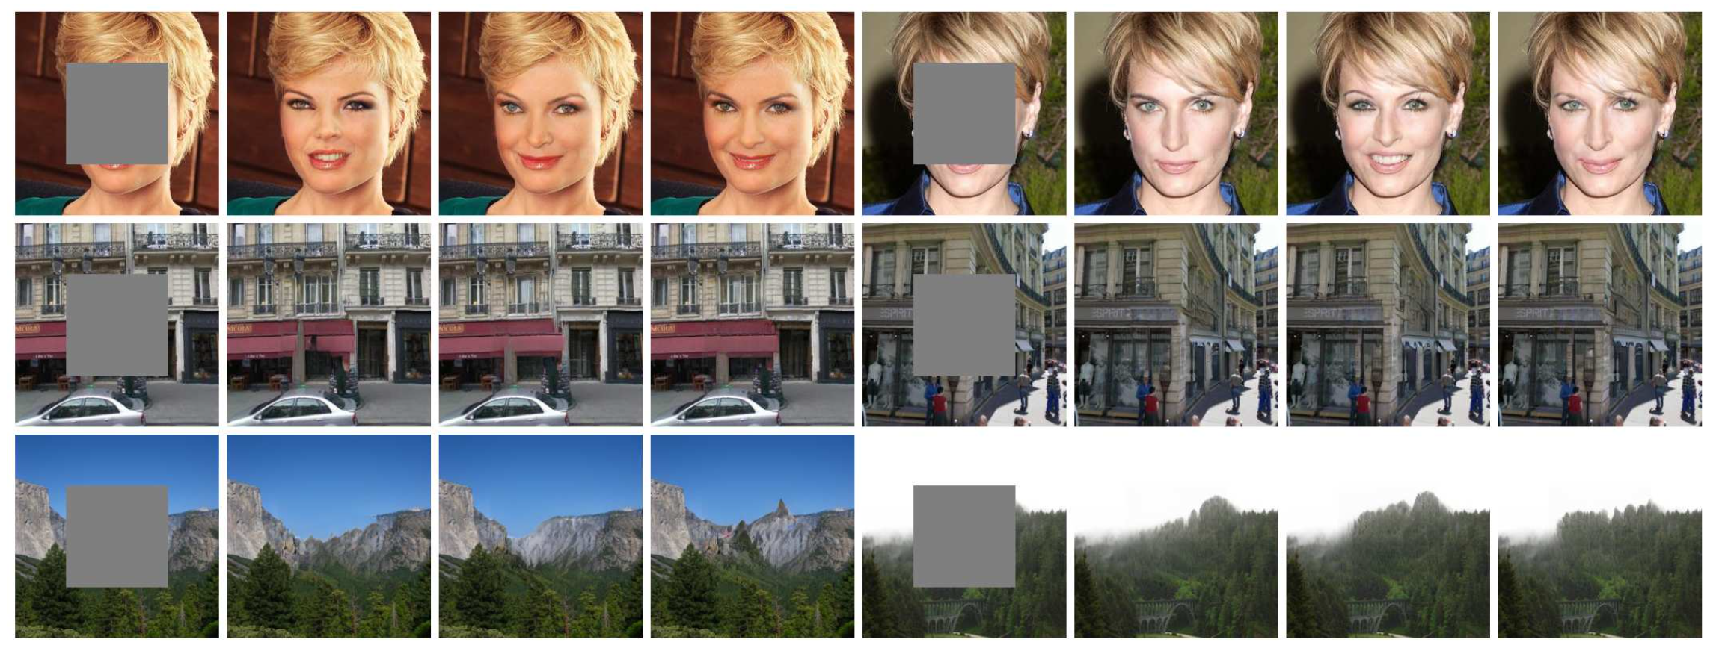
UCTGAN

Slide 4
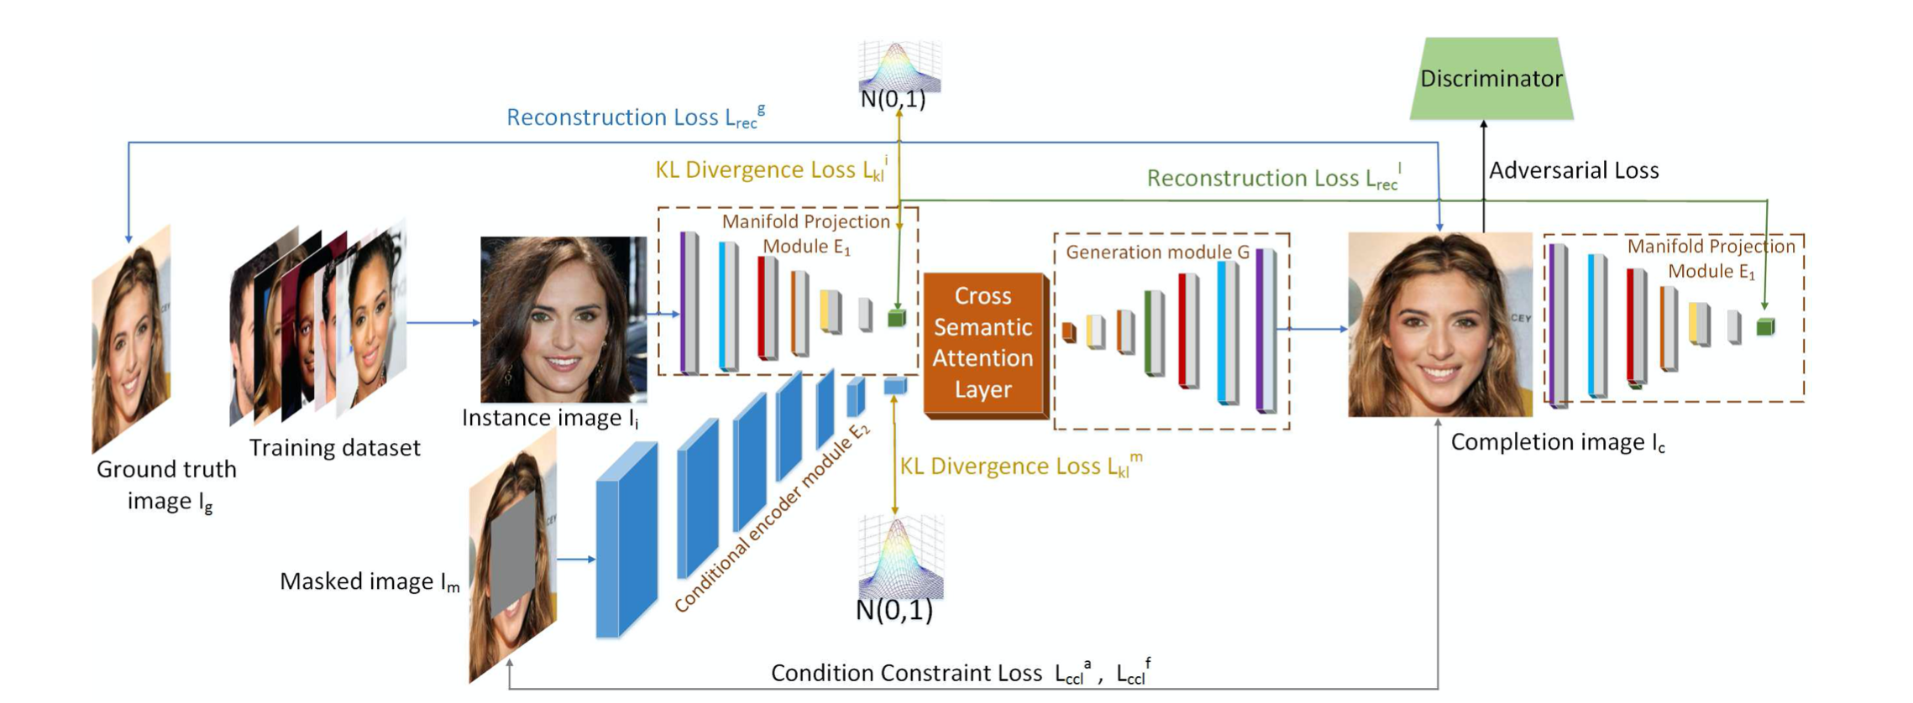
UCTGAN: Method

Slide 5
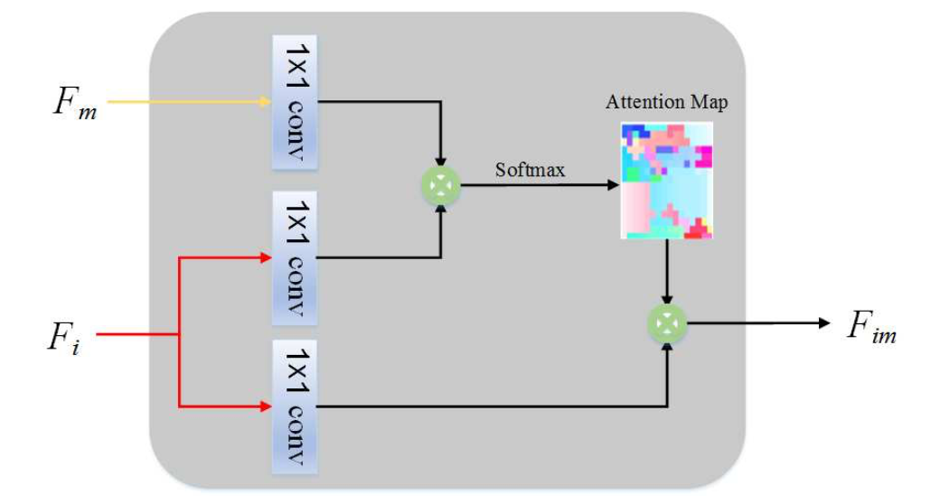
UCTGAN: CSA-Layer

Slide 6
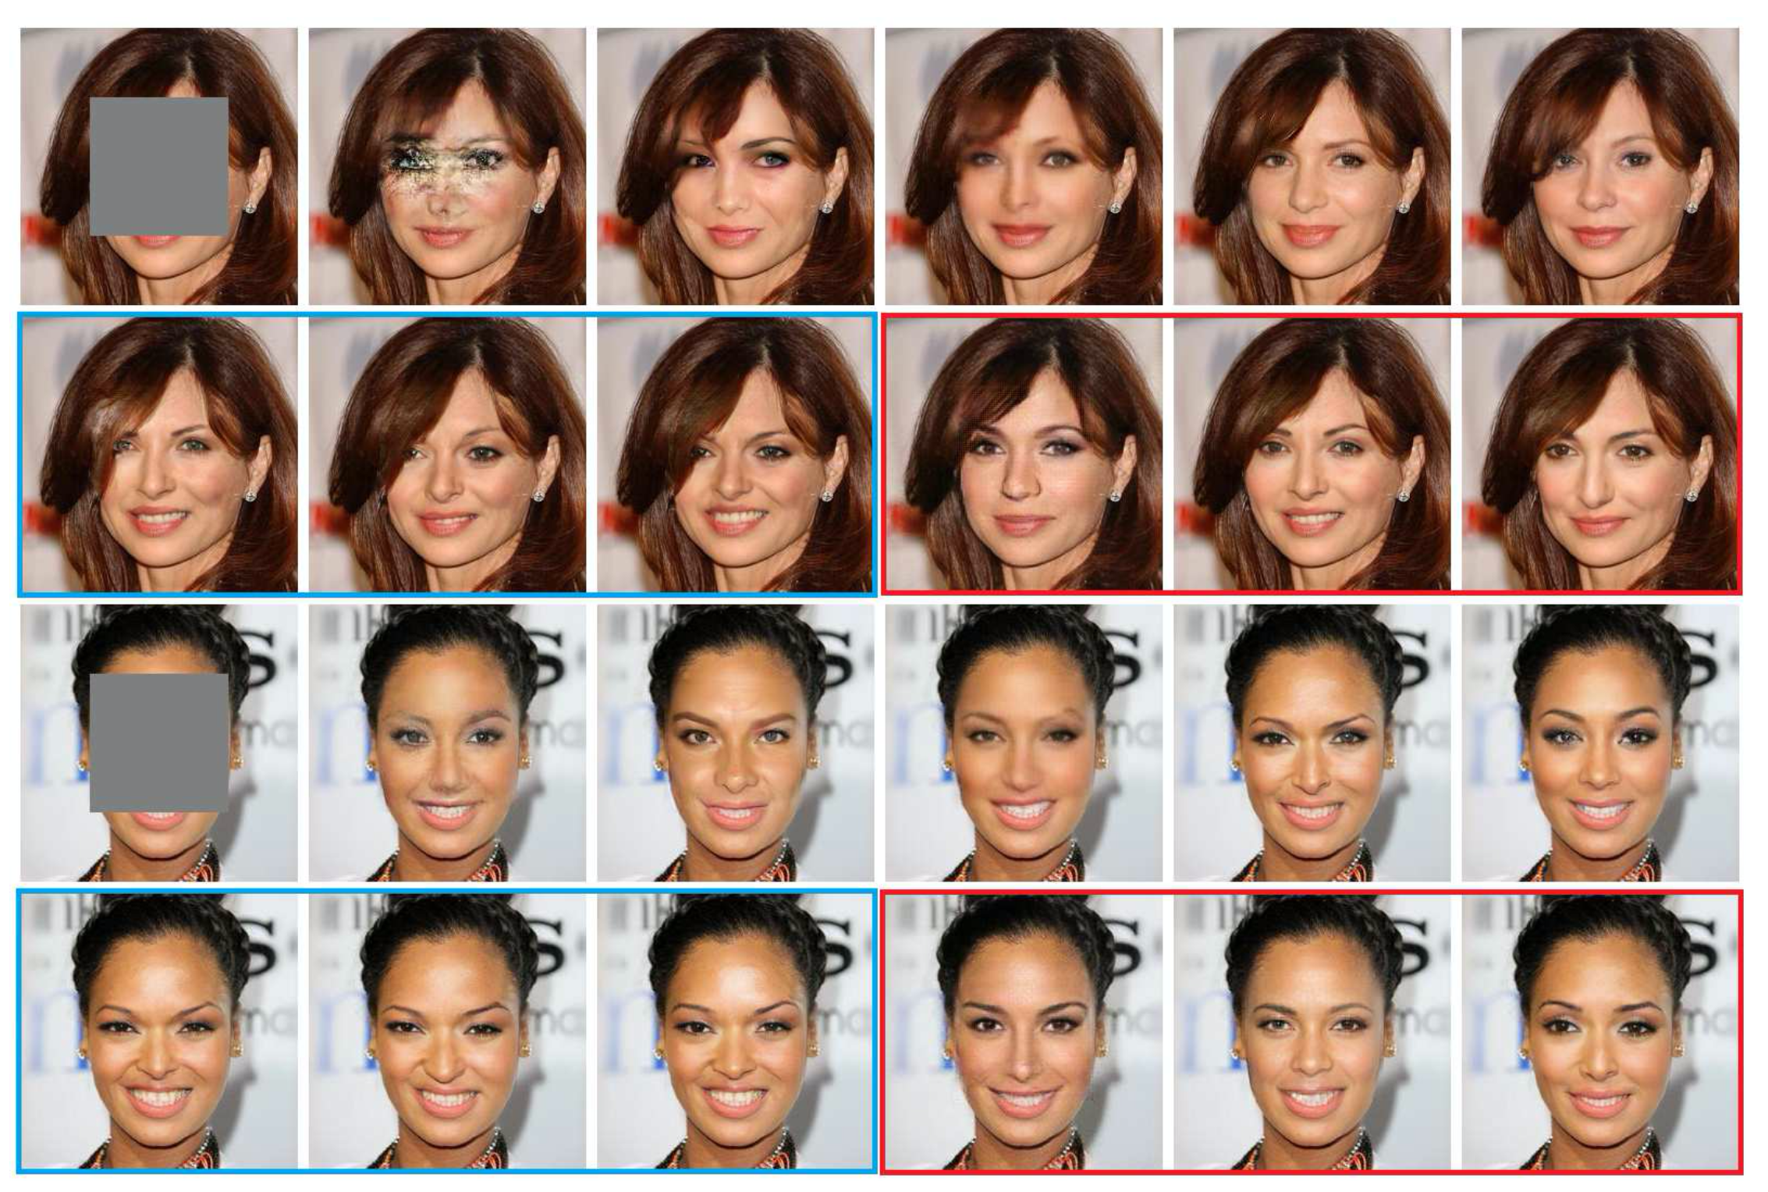
UCTGAN: Result

Slide 7
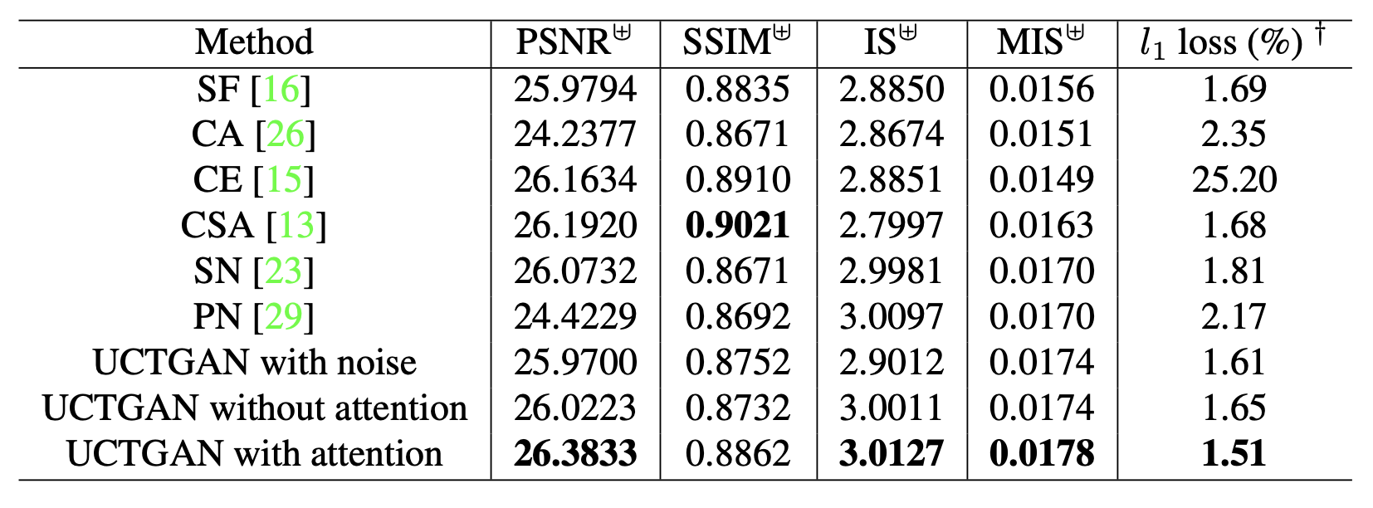
UCTGAN: Result

Slide 8
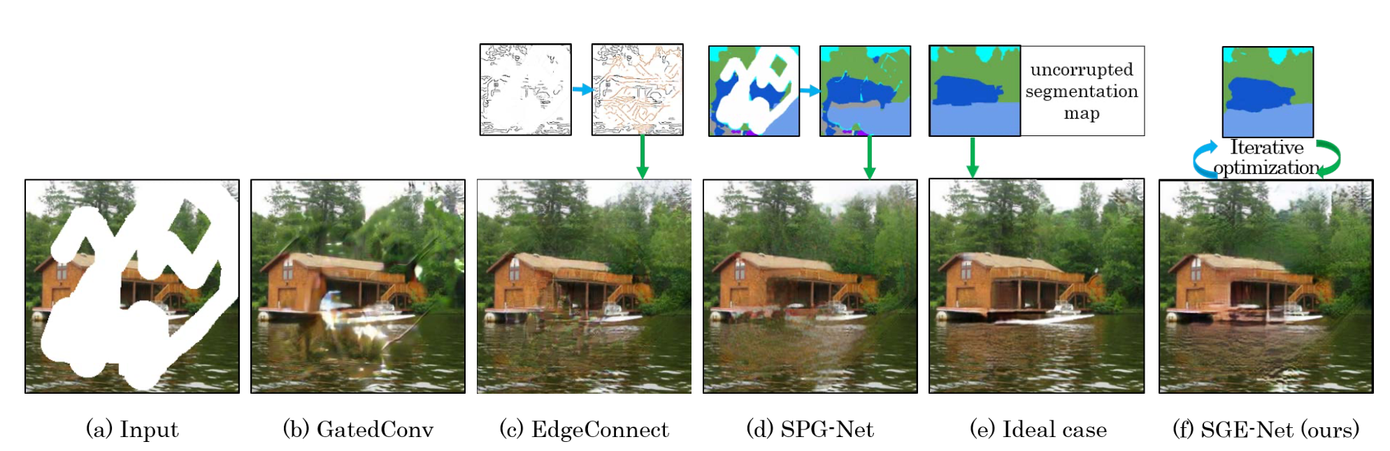
SGE-Net

Slide 9
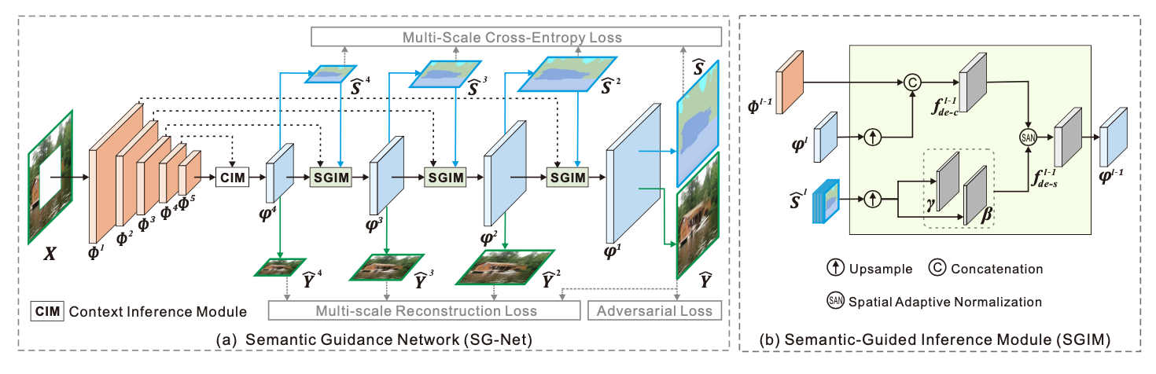
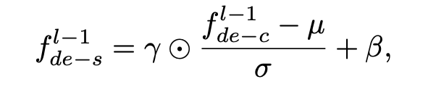
SGE-Net SG-Net

Slide 10
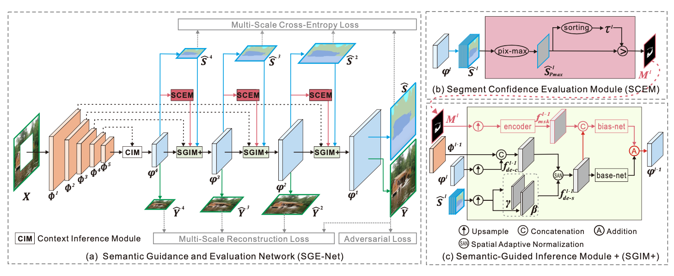
SGE-Net SGE-Net

Slide 11
SGE-Net SGE-Net

Slide 12
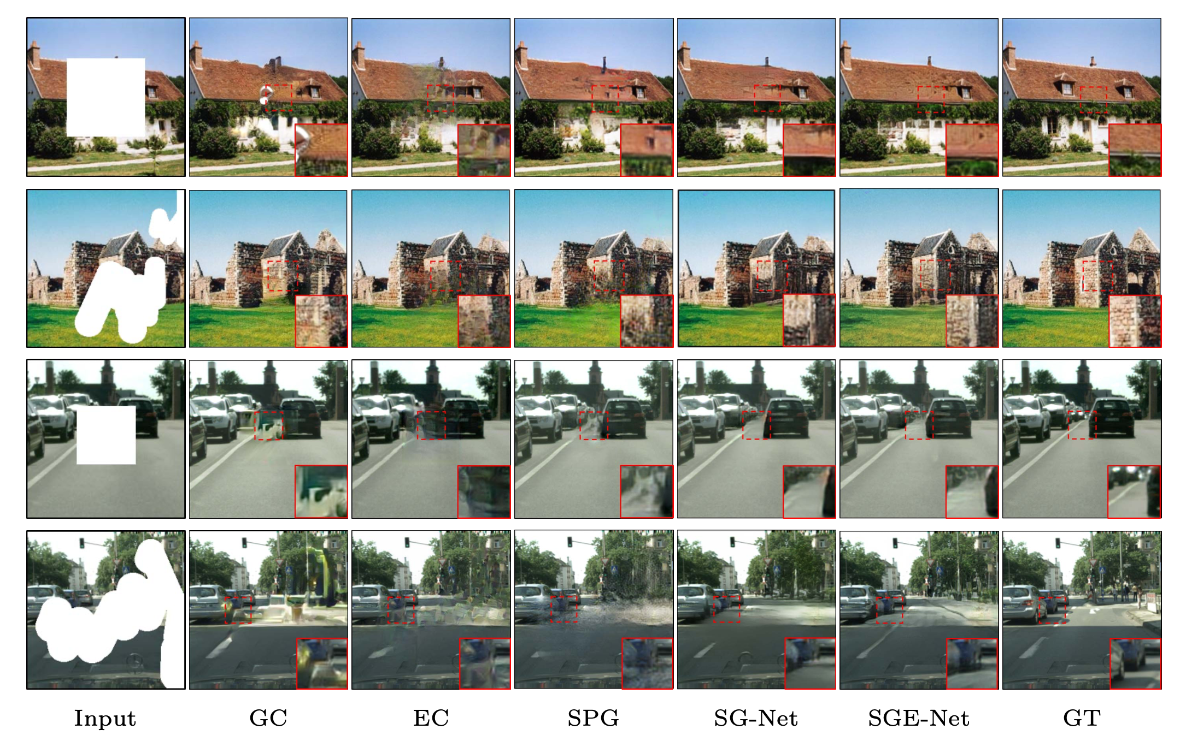
SGE-Net Result

Slide 13
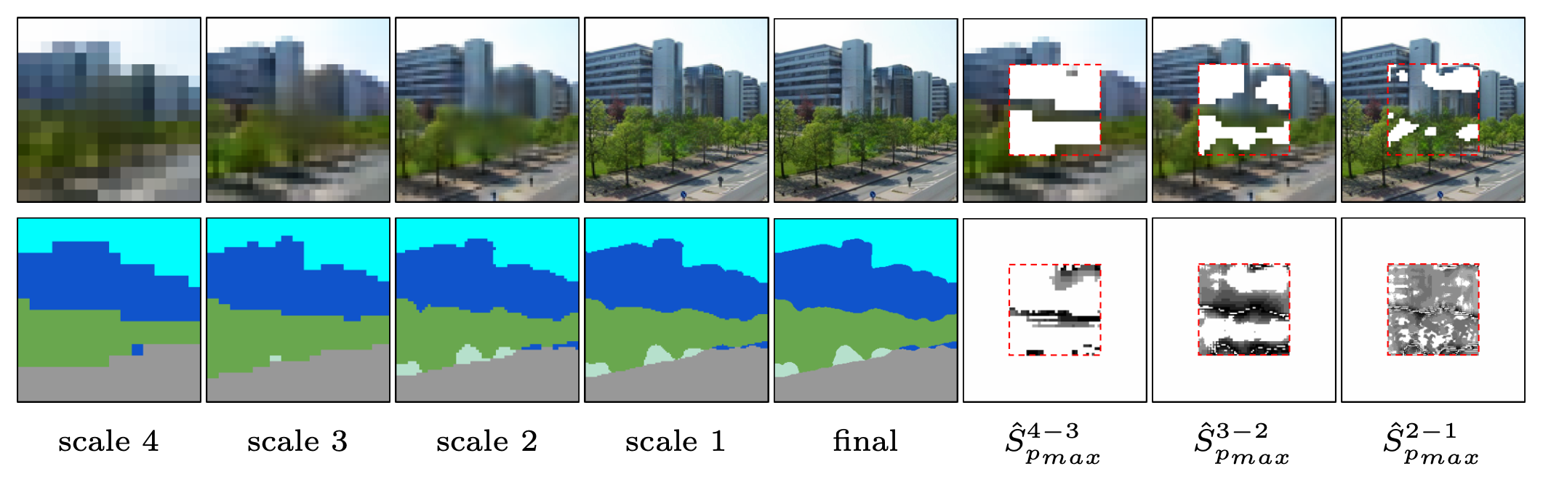
SGE-Net Result

Slide 14
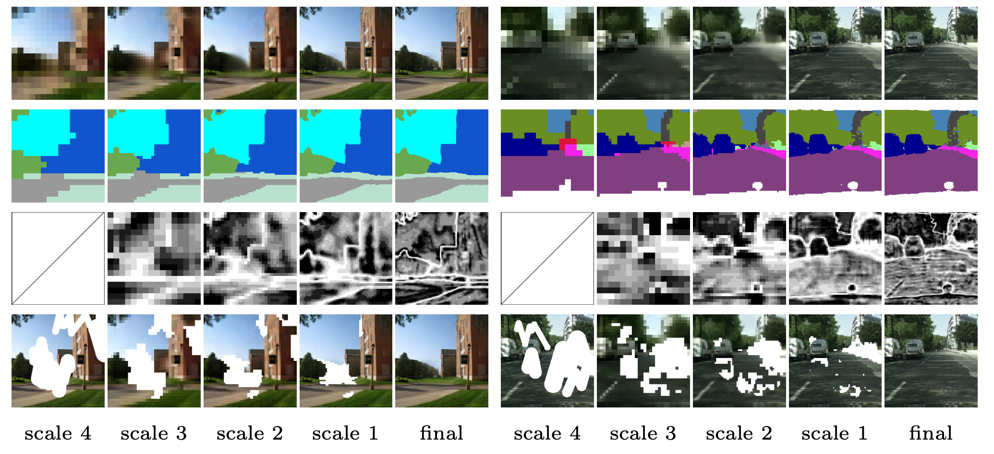
SGE-Net Result

Slide 15
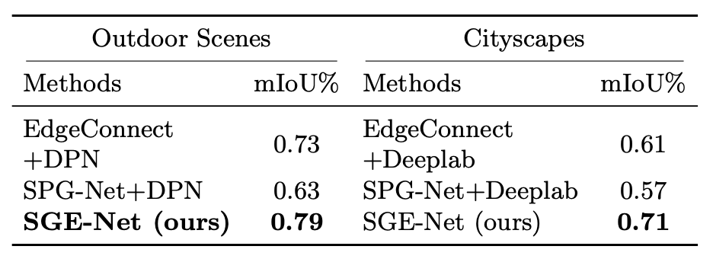
SGE-Net Result

Slide 16
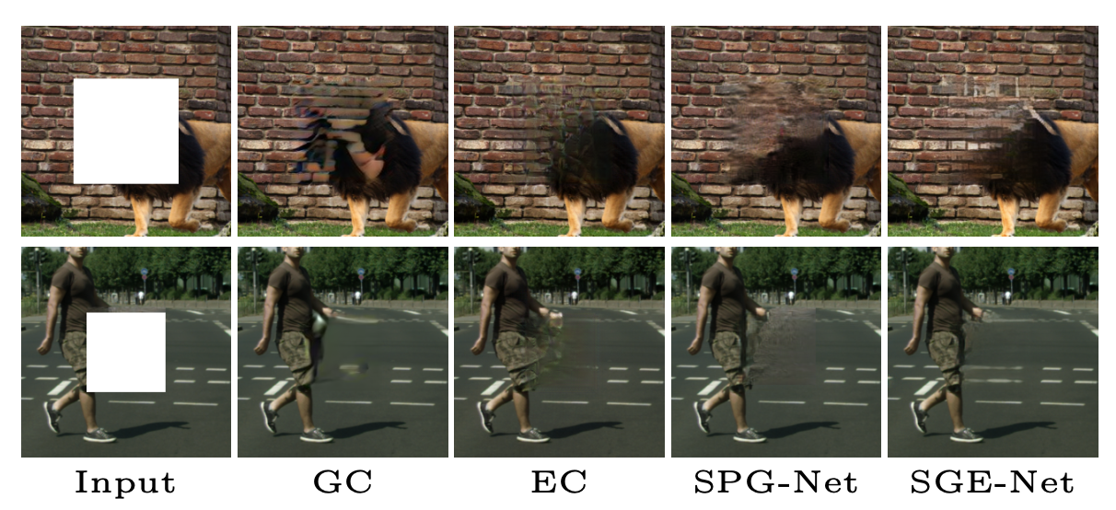
SGE-Net Failure Case

